Slide 1




Building a Personal Brand
Nnenna Ndukwe, Resilient Coders, Software Developer @ Bison

Slide 2
What is Personal Branding About?
How do you want others to see you with your online presence?
How can you begin getting yourself out there and increasing your online presence?
What platforms should you possibly utilize to increase your online presence and develop a personal brand?

Slide 3
Why Even Build a Personal Brand?
1. Putting oneself in the position of leadership
2. Credibility and expertise
3. Network building
4. A job
5. Getting to know the engineering/tech community locally and virtually
6. Building a network of people, which may ultimately lead to jobs

Slide 4
A Bit About Me
Hobbies
Reading
Writing
Coding
Volunteering
Originally from Texas
Moved to Boston in 2016
Past pursuits in Music and Social Sciences

Slide 5
What I Did to Build a Personal Brand & When I Started

Slide 6
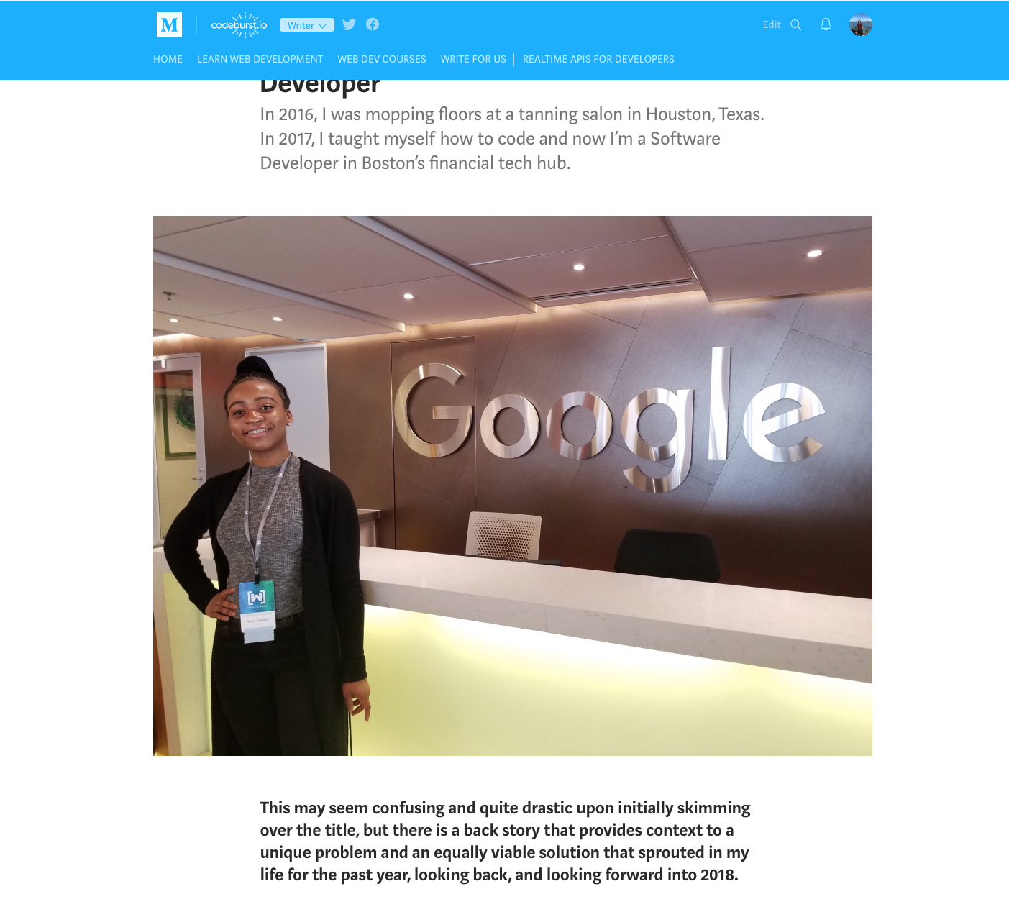
Write about Your Experience
Combine outside interests/hobbies with your professional career interests
January 2018 >> I began writing articles more frequently about my journey in the tech industry thus far in February
One of my articles, featured on Codeburst.io and POC in Tech, currently has over 9k views and over 4k 'applauds' on Medium from across the entire world

Slide 7
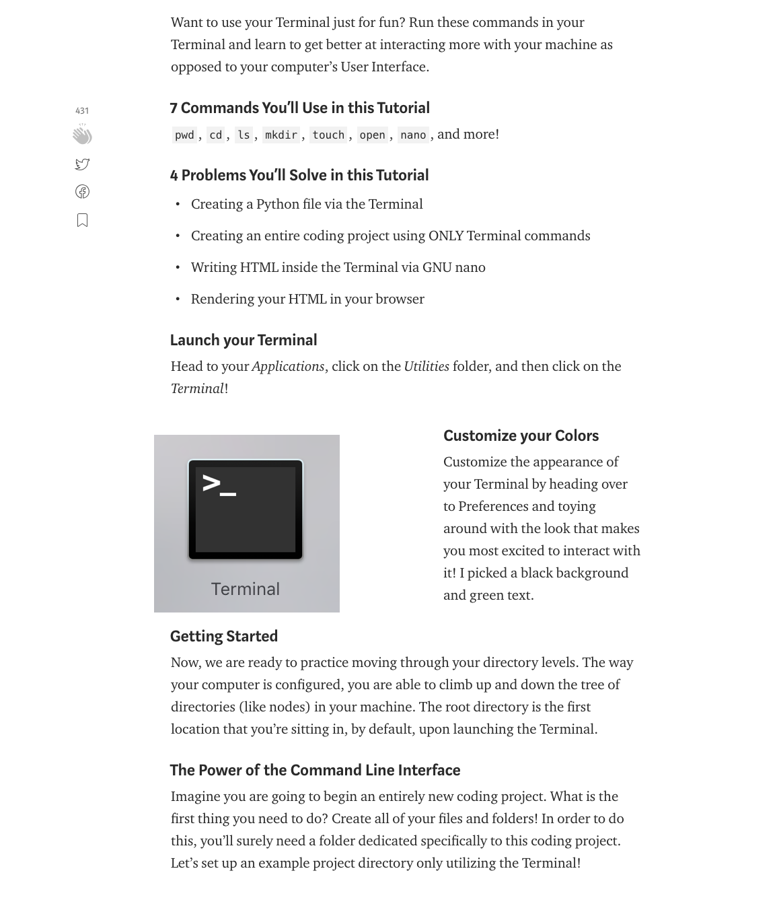
Promote Yourself
Every click matters! Increase engagements!
I write articles at least once a month and then promote them on:
Twitter
LinkedIn
GroupMe
and I let people on Slack know that I've made posts so they can support it as well!

Slide 8
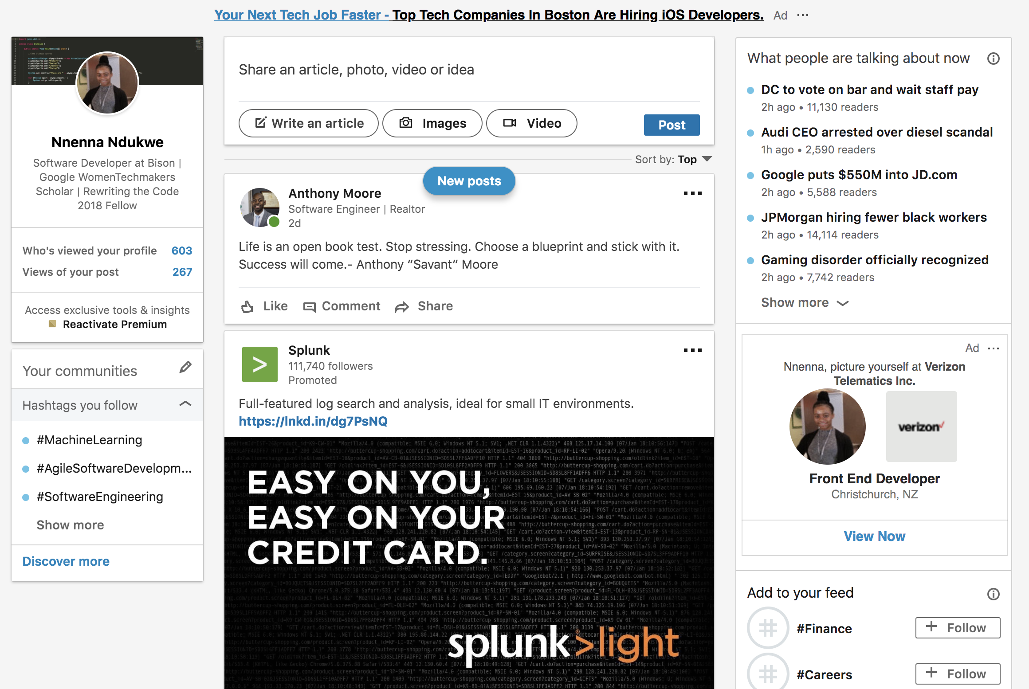
Promote Others
I began interacting with the dev community on Twitter and supporting people on Medium, Twitter, LinkedIn, YouTube, and more!
When you show support for others, they show it back to you!

Slide 9
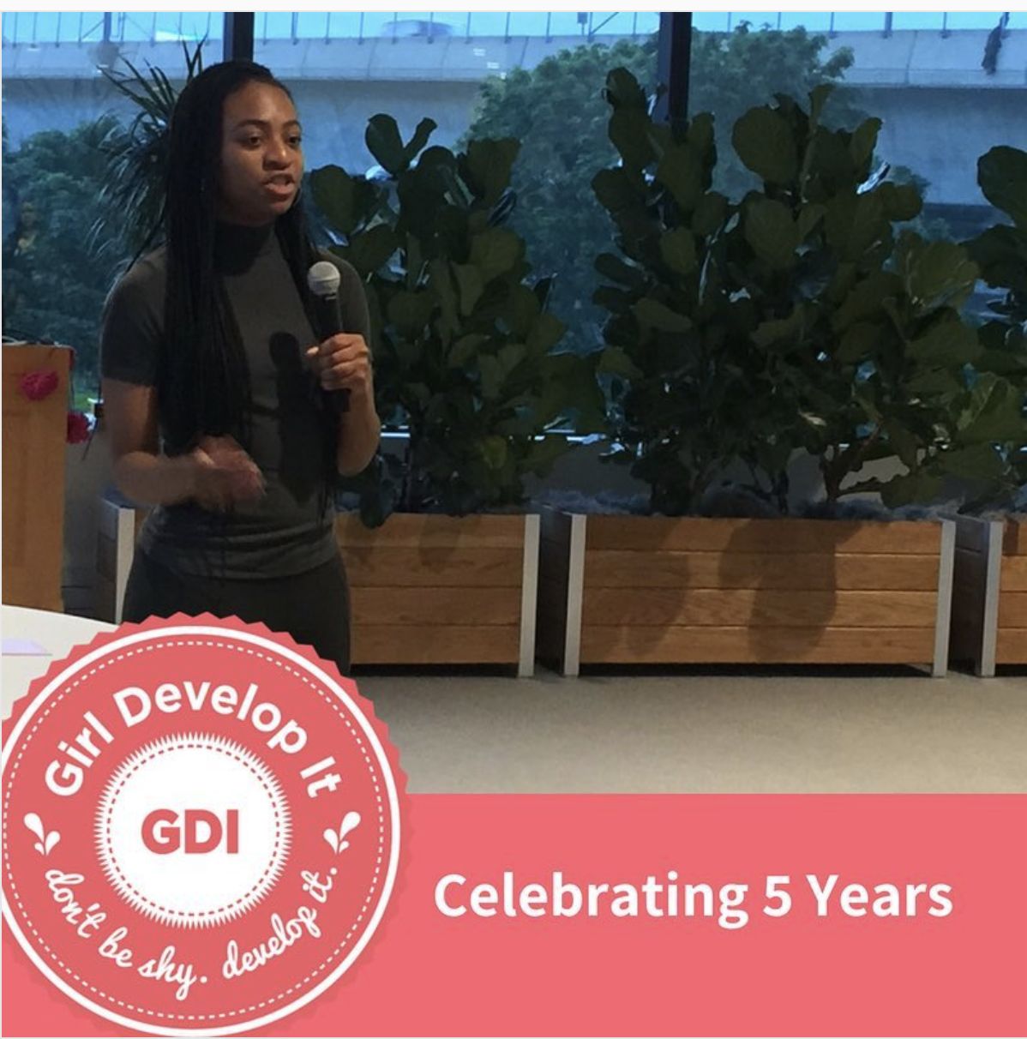
Networking & Volunteering
I would go out to networking events and begin serving for organizations whose missions matched with my personal mission and interests:
Girl Develop It
Black Girls Code
National Society of Black Engineers
Rewriting the Code

Slide 10
What Building a Personal Brand Has Done for Me

Slide 11
Personal Branding Showcases Your Qualities & Affords You Exclusive Opportunities
Passionate
Dynamic
Individual
With the reach of some of my articles, Google Engineers reached out to me to connect in Cambridge or Boston in person.
I receive more invitations to events that are a bit more exclusive and invitation-only.
I gave a lightning talk at Girl Develop It’s Anniversary Party on being a Python TA and my career thus far!
I have sat on a tech panel for Black Girls Code talking to little girls about my experience as a Software Engineer. The other black women on the panel all went through MIT and Harvard programs.

Slide 12
Exercise #1: Questions to Answer
Let’s begin brainstorming about what we want our own branding to look & feel like...

Slide 13
What do you want people to recognize you for? What do you want to be known for?
(e.g. If someone has heard about you and they mention you at a networking event, what would you ideally want them to describe you as as it pertains the skills you're gaining now and the skills you hope to gain in the near future.)
(E.g. Software Developer, Writer for Codeburst.io, active volunteer for GDI, etc.)
Jot down phrases and titles that you feel resonate with you and your goals.
Question #1

Slide 14
Question #2
What platforms would you like to utilize often in order to promote yourself? What platforms would you like to be able to leverage in order to facilitate your personal brand building?
List them.

Slide 15
Question #3
How often do you want to contribute to building your personal brand? Begin writing down your estimations.
E.g. “I want to commit to tweeting once a day.”
E.g. “I want to post an article once a month.”

Slide 16

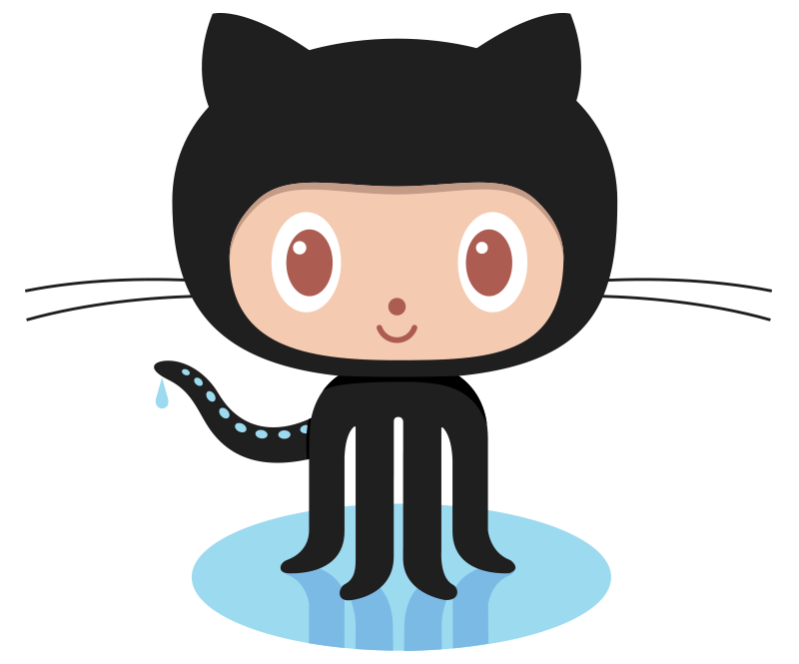
Exercise #2: Let’s Begin Building Our Personal Brands

Slide 17
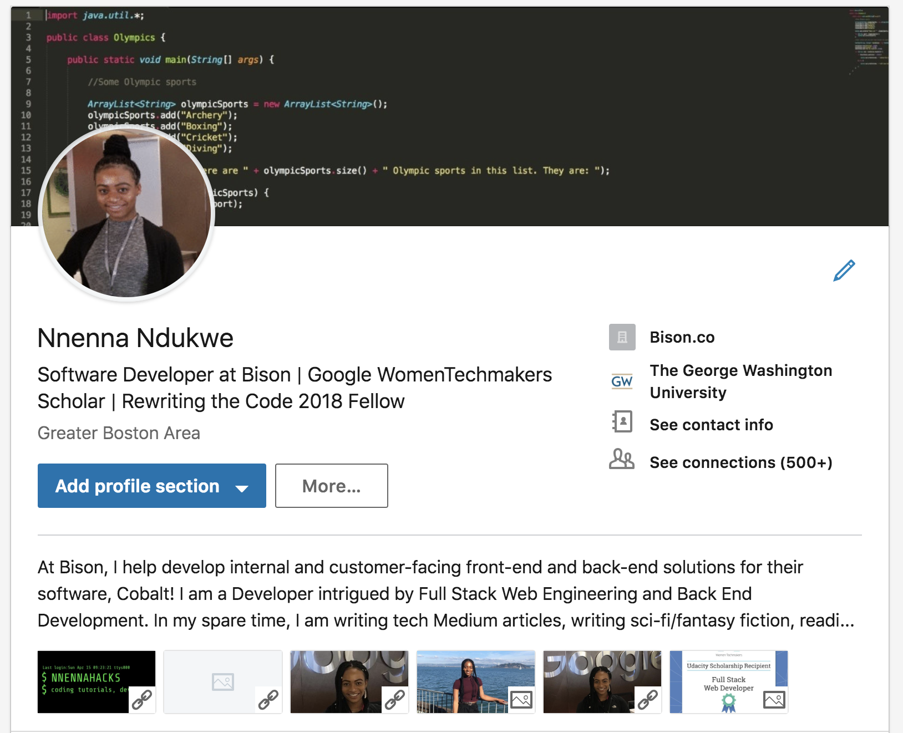
LinkedIn
Set up an inviting profile picture!
When making connections, personalize your Linkedin requests with a note!
Spend time creating a summary/bio that matches your current state of employment and your interests both in and outside of work!
Make your headline stand out!

Slide 18
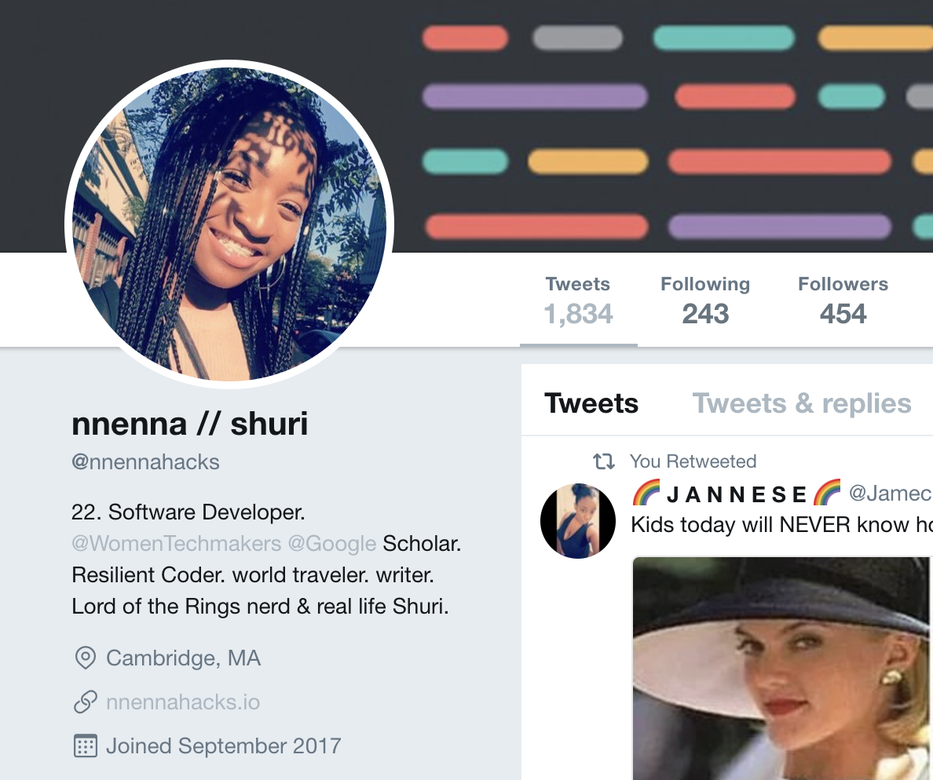
Twitter
If you’d like to utilize this platform, make sure you have a profile picture up
Begin following people and topics you resonate with, even if it’s beyond coding
Write a bio that’s true to YOU. Your Twitter is about showing your personality and interests, what you advocate for, etc.
Add a link to your profile that you’d want people looking at!

Slide 19
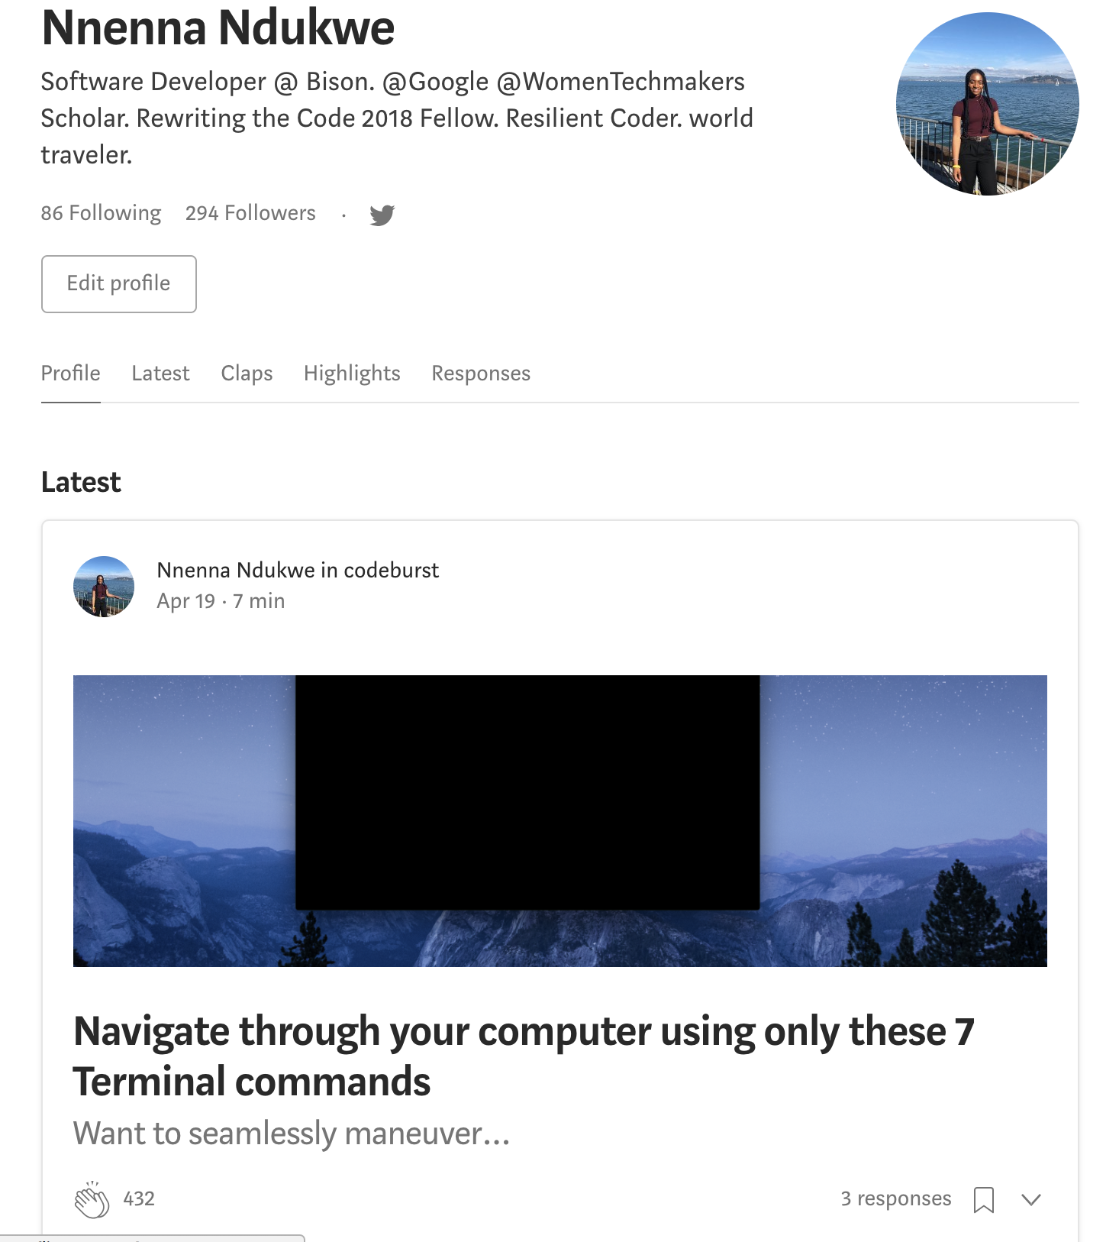
Medium
If you’d like to start writing about things that really interest you, set up a Medium account if you don’t already have one.
Set up a nice profile picture, follow others, create a bio similar to the bio’s on the other platforms.

Slide 20
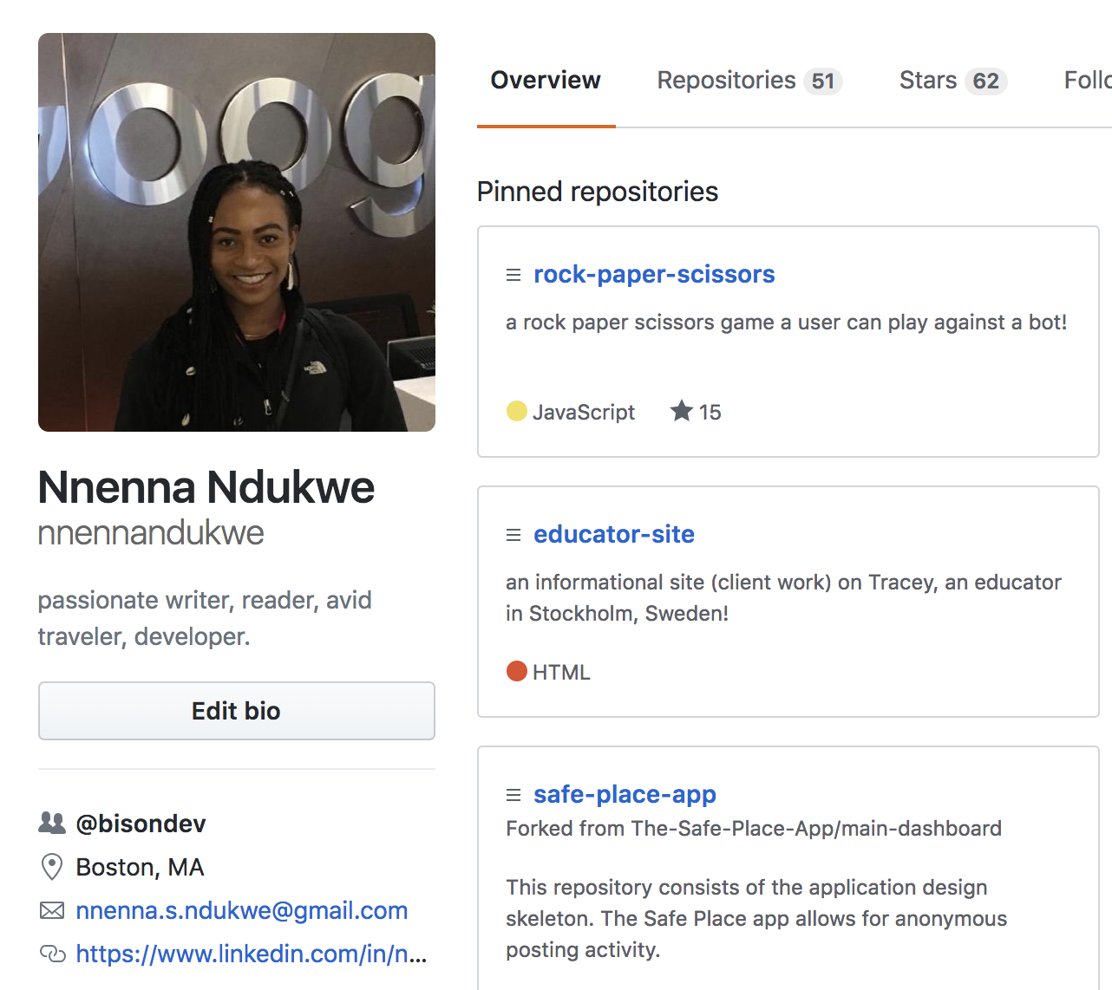
Github
Write a bio that reflects who you are!
Add a link that you’d want others to take a look at when they click on your profile.
Add an inviting photo to your profile

Slide 21
Connect all of Your Accounts to Strengthen Your Overall Presence!
For the link on Twitter, that URL should connect to something else you do or another social media networking site you’re on!
Twitter >> Medium >> LinkedIn >> Github >> Personal Site >> Client Work (Sites/Images)
This makes it easier for people to find you and see how active you are!

Slide 22

Buffer: Automate your postings to social media
Write posts ahead of time and set them up in a queue for the multiple platforms you utilize! Make the posting process quicker & easier!

Slide 23
Networking Tips I Wish I Knew A Year Ago...
Let alcohol work in your favor, not against you. Use it to ease into conversations more confidently if you feel that it may help while at these networking functions
In order to curate your own unique feeds, start a hashtag that can always be connected back to you! (e.g. On every LinkedIn post, I use the hashtag #nnennahacks)
Don’t overdo it! Pace yourself because it’s about quality, not quantity, but the consistency of that quality matters MOST.

Slide 24
Tips & Takeaways for Personal Brand Building
Building a network is how you actually get jobs
It's the small steps that matter
Personal brand is basically a growing form of currency for your personal life and your career
Get to talking on the platforms you currently utilize! Interact with others, support people, and support what you like!
When going to networking events, use LinkedIn to connect to people and make sure you leave a personalized note in the connection request
Inform people of when you have released new content for anything you're working on or have worked on; letting people know what you've been up to (when you're ready) keeps people updated!
Getting active online and building your personal brand is how you are better able to pitch yourself to people and potential employers!
Engage in certain activities that you feel align with your passions and goals and slowly reduce the amount of distractions of things in your life that do not serve you where you're headed
Behave online and in person in a way that you feel is reflective of the person you want to be known as and for.
Notes:
(e.g. I went to a restaurant on Thursday and I wasn't expecting to see a lady who is in Amazon Robotics in Cambridge; I had met her at a Diversity & Inclusion Tech Panel. Another e.g.: At that same restaurant, I happened to meet someone who had read my article and we talked about programming. He is an engineer. We connected on LinkedIn right then and there. It can happen at any place and at any time because your online presence impacts others! Leverage that to increase your success in different ways)

Slide 25
Q&A
Ask me anything! Let’s discuss.
Nnenna Ndukwe

